Slide 1


Analysis of the connectivity of hydrides within the microstructure of Zr alloys
Research Software Engineering Practice
Group 2
Wunmi Olukoya, Jamie McGregor, Enn Veikesaar and Laura González Duque
03/06/2021

Slide 2
Content
Image processing in Python
Determining connectivity
Creation of functions in the code
Testing of the code
Written report

Slide 3
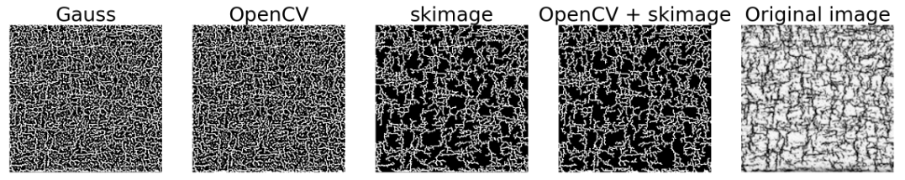
Image processing - Gaussian thresholding
Adaptive Gaussian thresholding - poor results
Noise removal necessary, but results are inconsistent

Slide 4
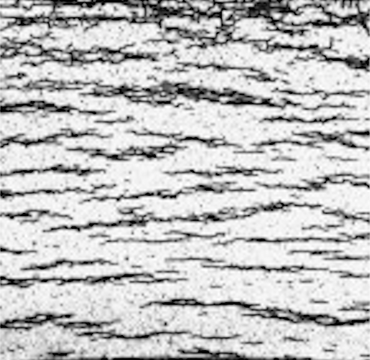

Methodology
1
Notes:
Aluminium alloys are among the most worldwide demanded alloys and their demand grows every year because they count on many advantageous characteristics, being the principal their low density and low price, especially of interest in the vehicle sector. The European Aluminium association estimated a 40% growth in demand for aluminium between 2019 and 2050. Aluminium sheets are the most popular way of use of this material and they are widely employed in many relevant sectors because they can be cut and formed into different desired shapes. Therefore, there is a strong incentive to optimise the performance of this product and competition in the market is very strong.

Slide 5
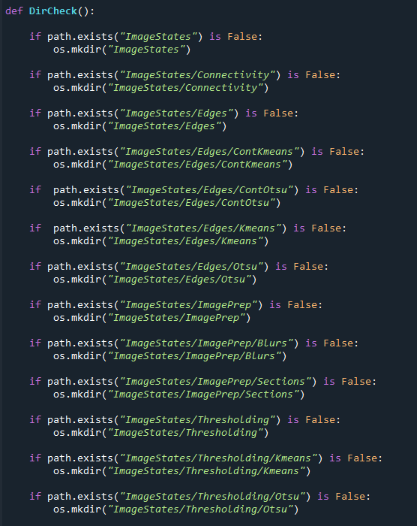

Slide 6
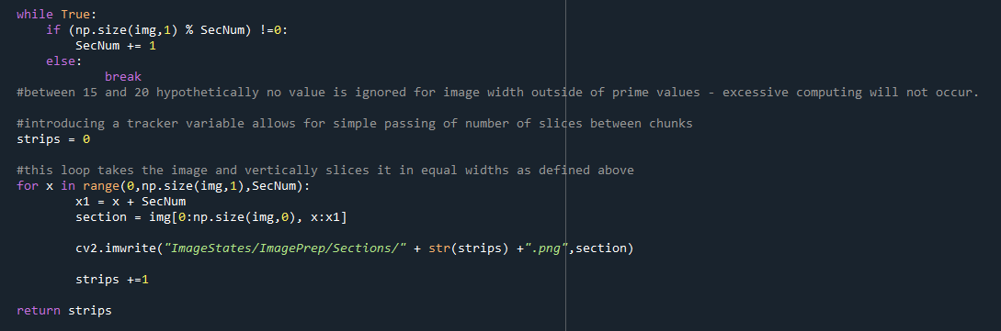

Slide 7
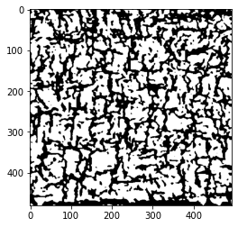
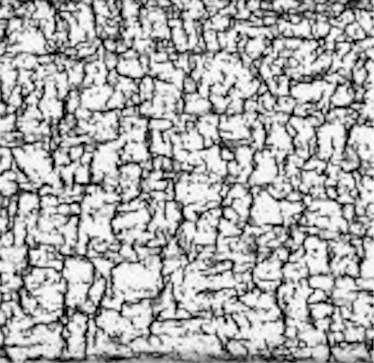

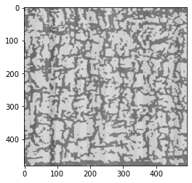
1
Notes:
Aluminium alloys are among the most worldwide demanded alloys and their demand grows every year because they count on many advantageous characteristics, being the principal their low density and low price, especially of interest in the vehicle sector. The European Aluminium association estimated a 40% growth in demand for aluminium between 2019 and 2050. Aluminium sheets are the most popular way of use of this material and they are widely employed in many relevant sectors because they can be cut and formed into different desired shapes. Therefore, there is a strong incentive to optimise the performance of this product and competition in the market is very strong.

Slide 8
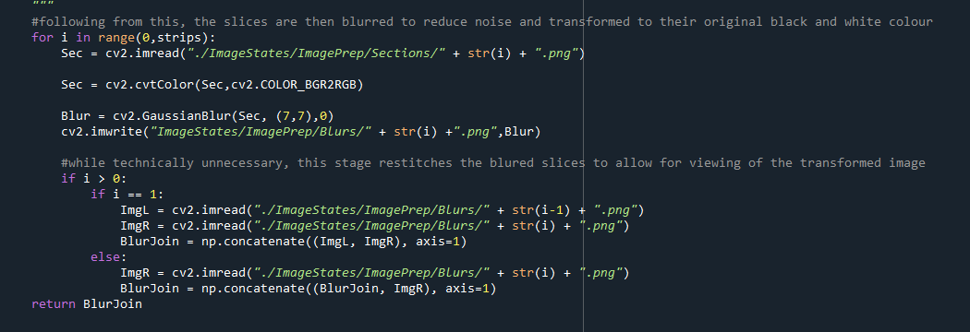

Slide 9
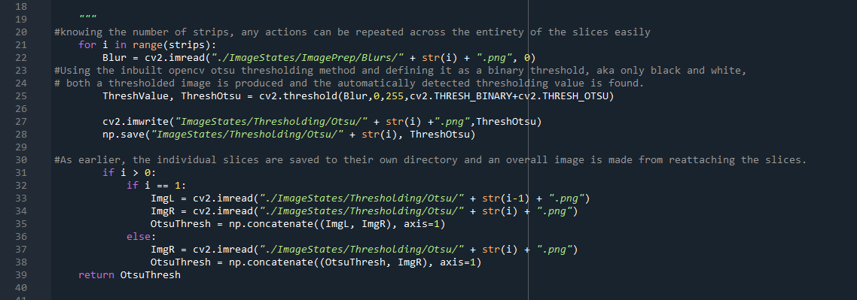

Slide 10
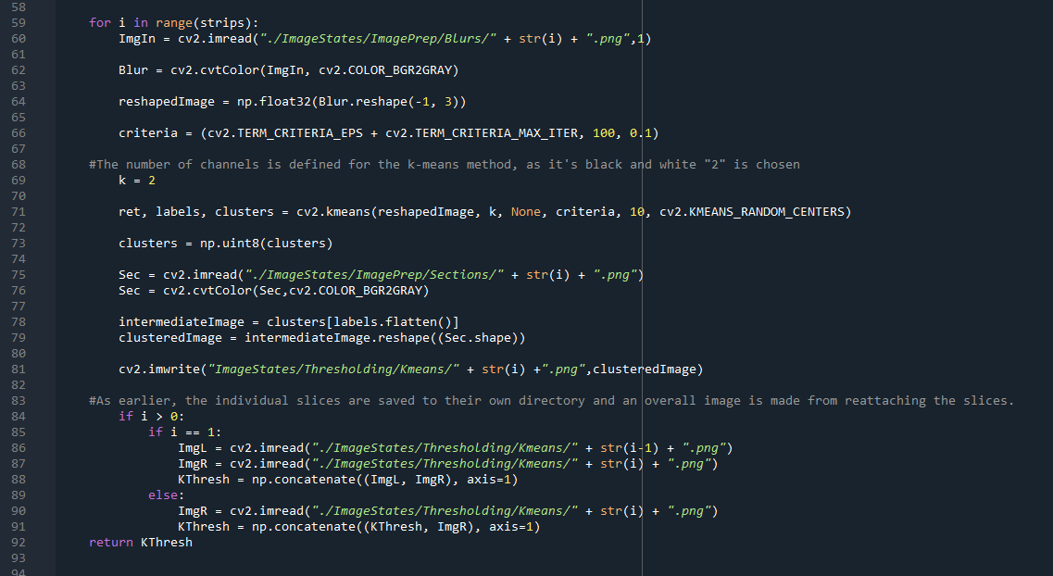

Slide 11
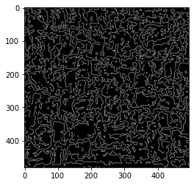

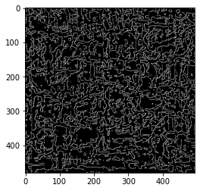
1
Notes:
Aluminium alloys are among the most worldwide demanded alloys and their demand grows every year because they count on many advantageous characteristics, being the principal their low density and low price, especially of interest in the vehicle sector. The European Aluminium association estimated a 40% growth in demand for aluminium between 2019 and 2050. Aluminium sheets are the most popular way of use of this material and they are widely employed in many relevant sectors because they can be cut and formed into different desired shapes. Therefore, there is a strong incentive to optimise the performance of this product and competition in the market is very strong.

Slide 12
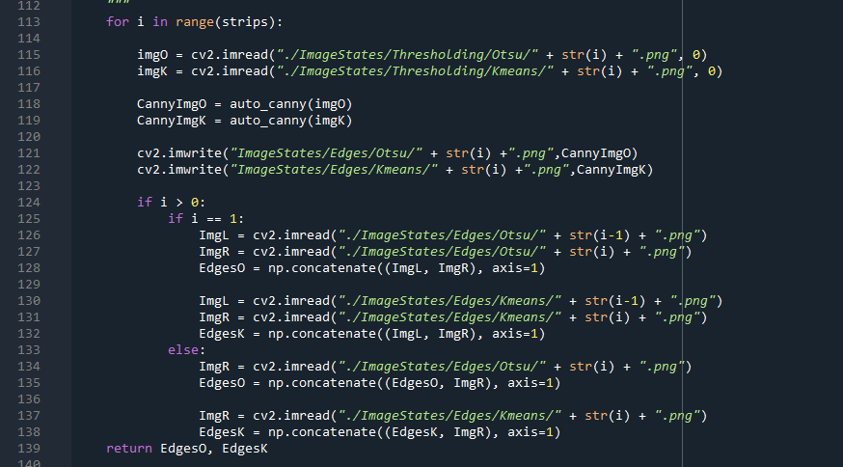

Slide 13
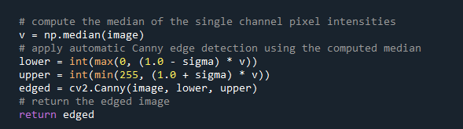

Slide 14
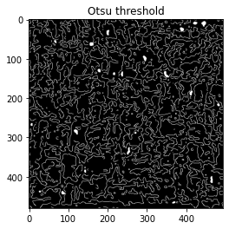
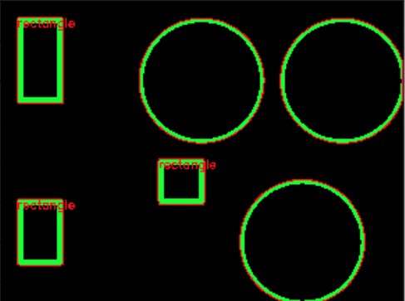
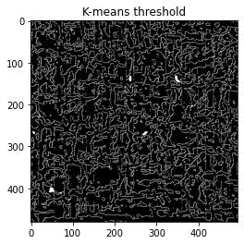
1
Notes:
Aluminium alloys are among the most worldwide demanded alloys and their demand grows every year because they count on many advantageous characteristics, being the principal their low density and low price, especially of interest in the vehicle sector. The European Aluminium association estimated a 40% growth in demand for aluminium between 2019 and 2050. Aluminium sheets are the most popular way of use of this material and they are widely employed in many relevant sectors because they can be cut and formed into different desired shapes. Therefore, there is a strong incentive to optimise the performance of this product and competition in the market is very strong.

Slide 15
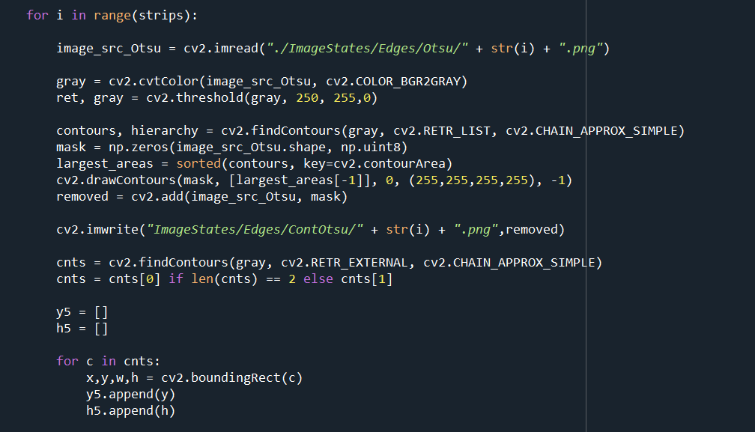

Slide 16
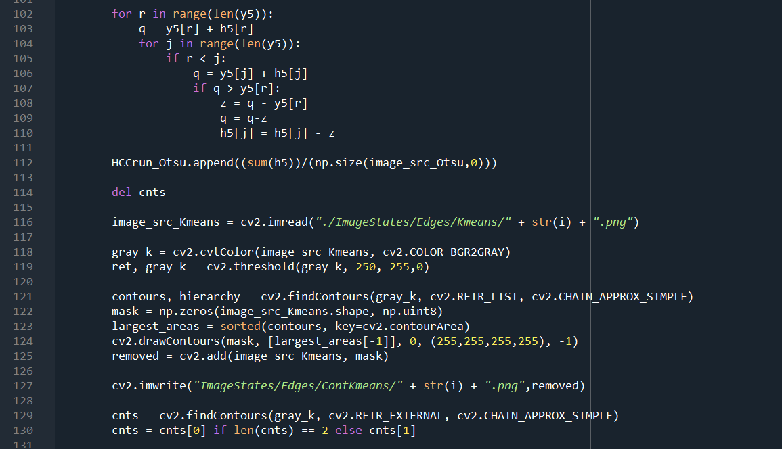

Slide 17
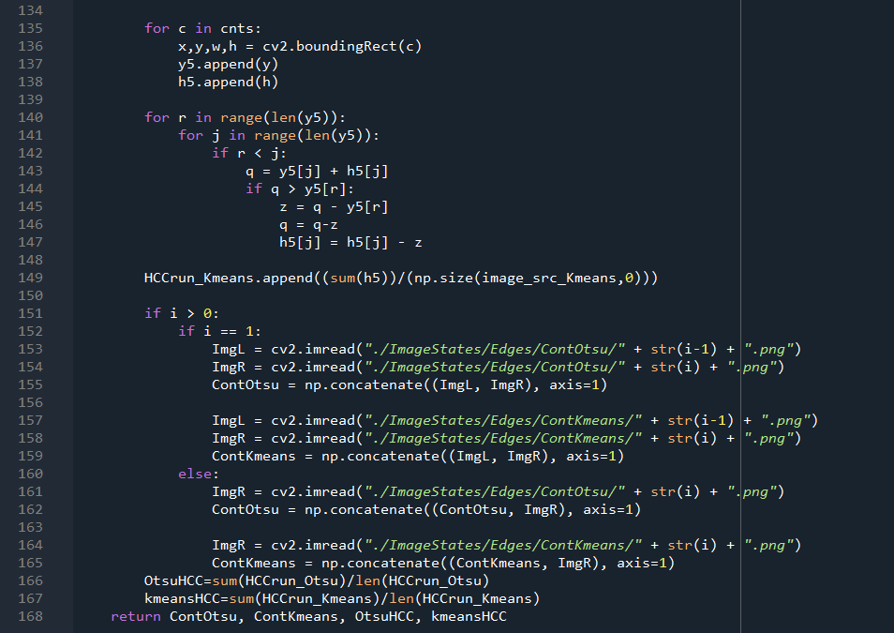

Slide 18
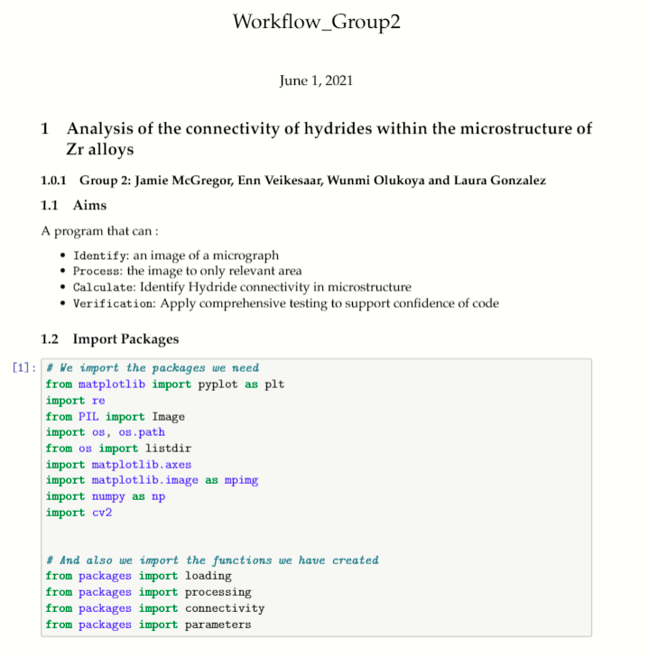
Creation of functions in the code
Structure of the demo notebook
Import packages
Import images
Image processing
Thresholding
Connectivity
Notes:
Once the code has been developed, we introduce our code into functions, and we create a demo notebook to show the user how to use the functions.
We used Jupyter to write it, and we structured it with these sections listed on the right, which includes the packaging importing to import all the packages needed (the python modules and the modules that we created with our own code), the import of the image we are going to process, the image processing and finally the thresholding and connectivity calculation and plotting.

Slide 19
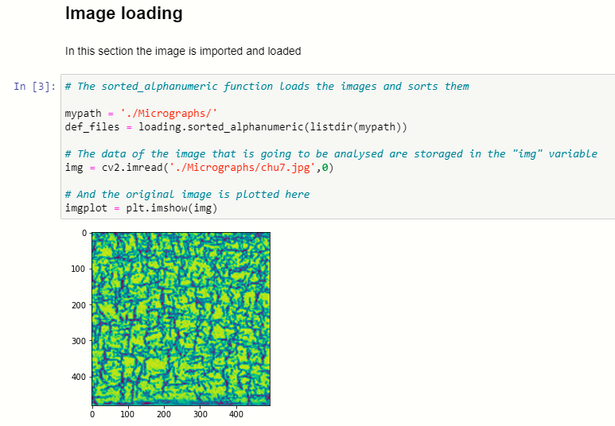
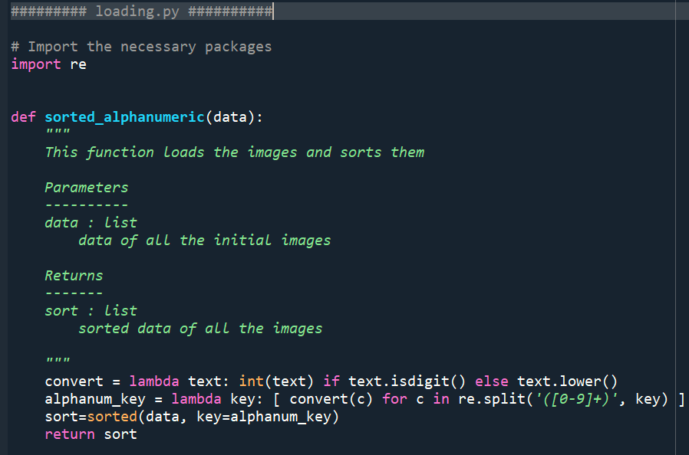
Creation of functions in the code
Description
Calling the function
Plotting the result
Notes:
In each section we describe briefly at the beginning what is going to be done in the section. Then, we call a function that has been stored on a .py file. And finally we plot the result.
Here in the right part of the slide we can see an example of one .py document. All the .py documents have the same structure. We import the needed packages first, then we define the name and inputs of the function or functions with their corresponding descriptions at the beginning, their code and finally their return.

Slide 20





Testing Processing
1.
2.
3.
4.
5.
Choose function to be tested
Set up environment
Define pass/ fail criteria using assert statement
Failed test -
Git outputs a x next to commit
Passing test
Notes:
Testing is a crucial part of python programming , expecially when the program is going to be used by or modified by other people.
A unit test checks a small component in your application
An integration test checks that components in your application operate with each other.
cation.

Slide 21
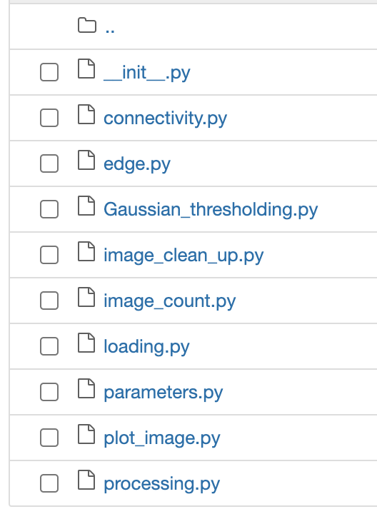
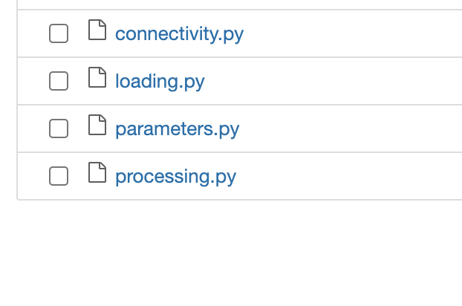
1. Functions to be tested
Notes:
CHoo
A unit test checks a small component in your application
An integration test checks that components in your application operate with each other.
cation.

Slide 22
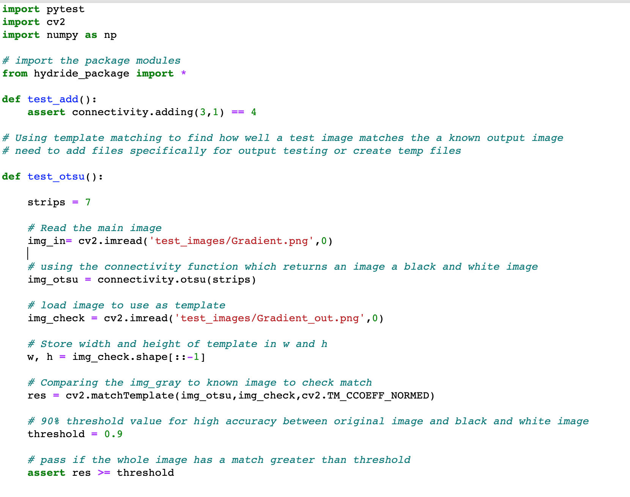


2. Connectivity.otsu
Aim:
Compare an input image to an output image after using the otsu function.
Input
Pass Criteria
To Improve:
Making output image inline with otsu function
Make it work –
Understanding the function better

Slide 23
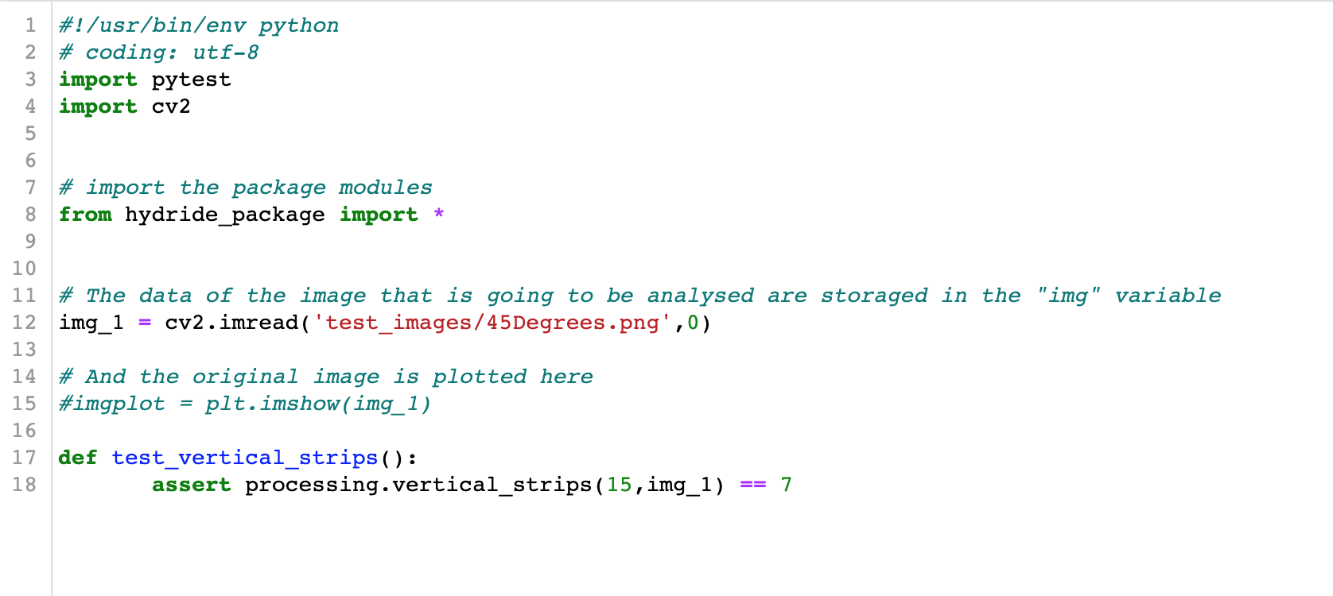

3. Processing.vertical_strips
Aim:
Build a test that that’s a .png file of of a known width and height then compares it to a previously calculated value.
Input
Pass Criteria
== 7
889 png x 500 png

Slide 24


3. Processing.blur
Input
Pass Criteria
Aim:
Test blurring of an input image when passed through Processing.blur
Notes:
Similarity to known output by using a threshold value

Slide 25

3. Parameters.hcc
Aim:
Numerical value for radial hydride that matches known examples.
Input
Pass Criteria
== 0
== 1

Slide 26

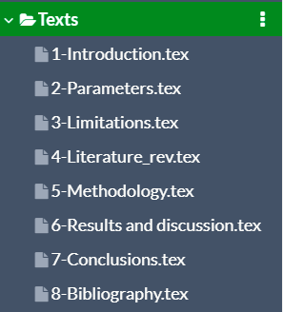
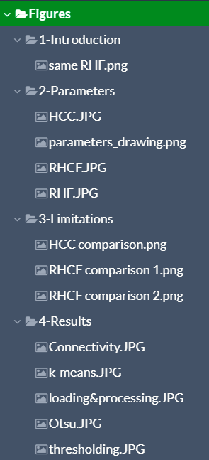
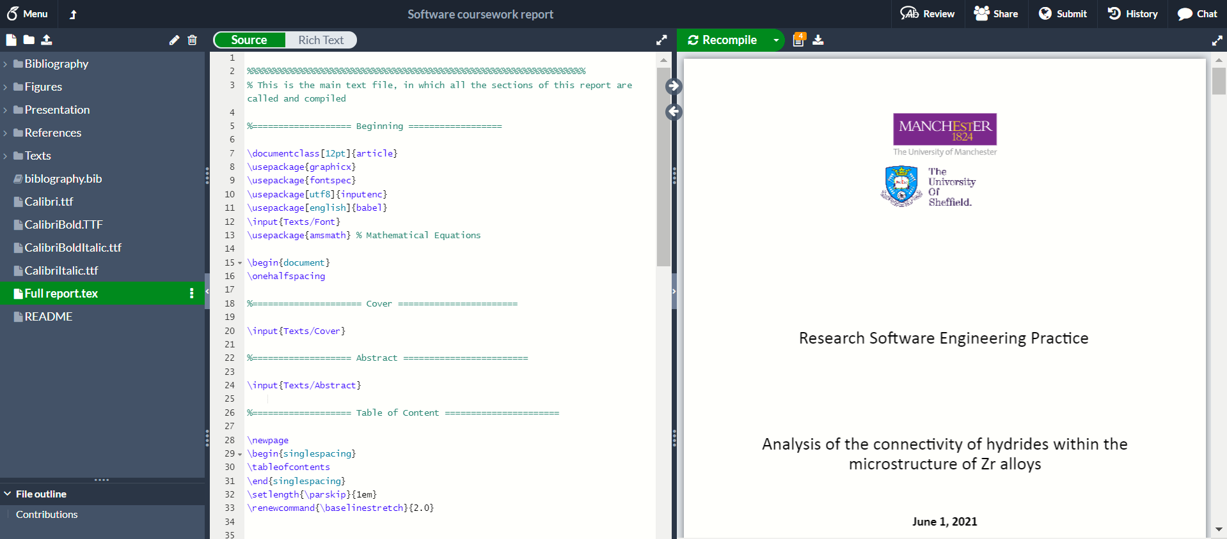
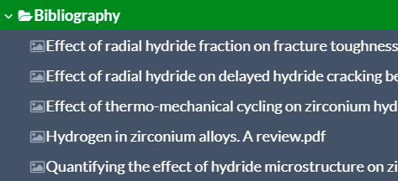
Written report
Notes:
To write the report as a latex document we used the editor Overleaf. Here you can see how it looks like and how we divided the content of the report into different folders, tidying the images and sections into different folders and subfolders.

Slide 27
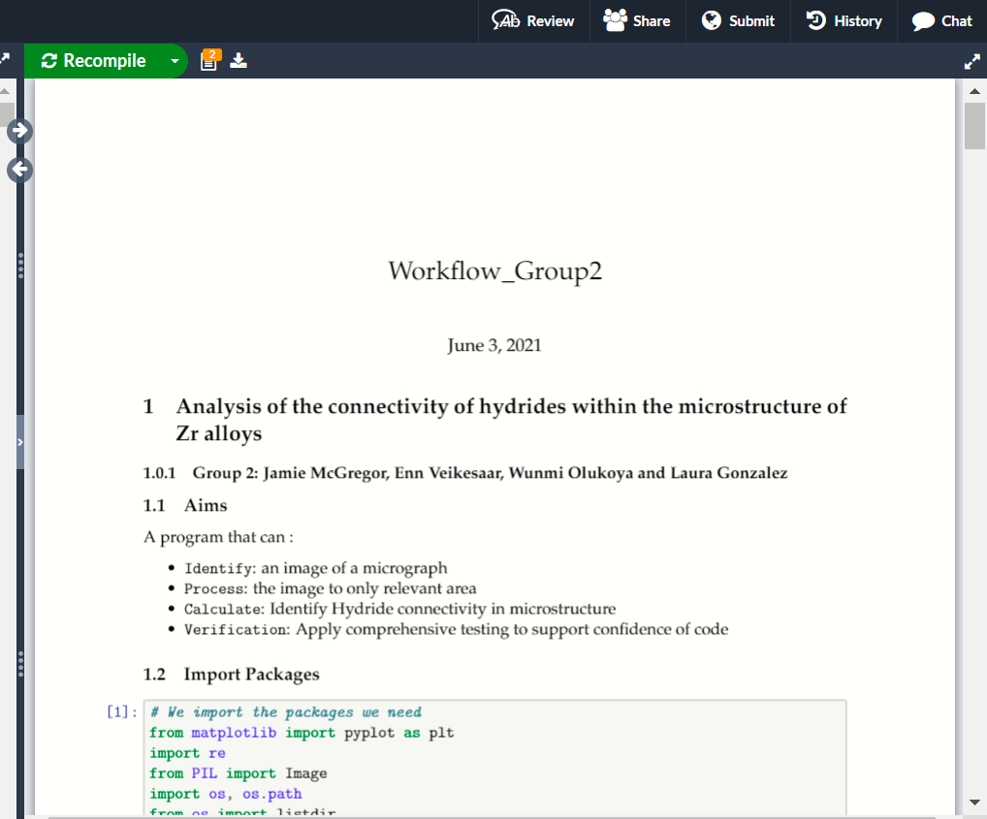
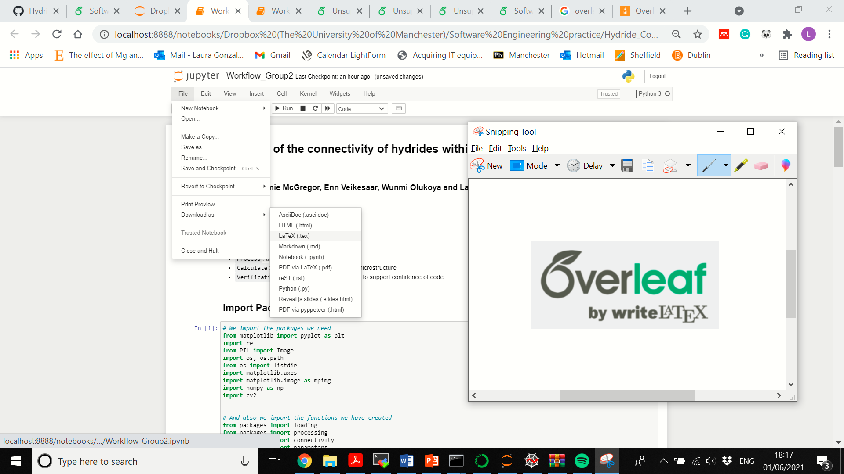
Written report
Notes:
One thing that we discovered is that our Jupyter notebook can be saved as a latex file too, so we can add our coding to the report avoiding copy and paste manually when we want to introduce part of the code in the report.

Slide 28
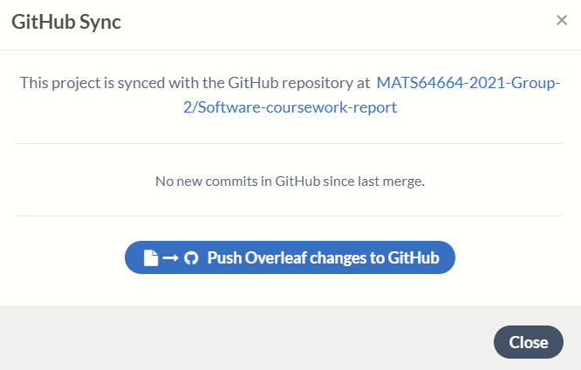
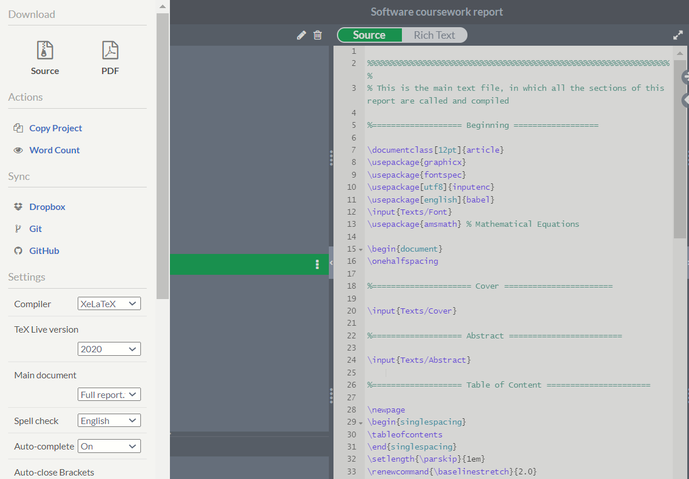
Written report
Notes:
About the version control, we can push our changes directly from Overleaf to GitHub by clicking on the GitHub option in the menu.

Slide 29
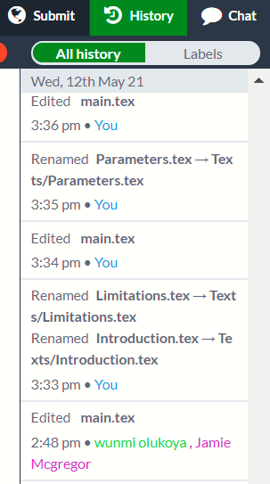
Written report
Notes:
But Overleaf has its own system to track the changes and the authors of the changes too. You just need to click here, on the History button, and you can restore old versions or just see the changes that were made.

Slide 30
Thank you

